Slide 1
Electrical
and Electronics science
First year
Computer Science and Engineering
Dr. Shakti Singh
ASSISTANT PROFESSOR
ELECTRCIAL AND INSTRUMENATION
ENGINEERING DEPARTMENT
@shakti.singh@thapar.edu

Slide 2
Types of Diodes and Their Uses
PN Junction Diodes:
Are used to allow current to flow in one direction while blocking current flow in the opposite direction. The pn junction diode is the typical diode that has been used in the previous circuits.
A
K
P
n
Schematic Symbol for a PN Junction Diode
Representative Structure for a PN Junction Diode
Zener Diodes:
Are specifically designed to operate under reverse breakdown conditions. These diodes have a very accurate and specific reverse breakdown voltage.
A
K
Schematic Symbol for a Zener Diode

Slide 3
Types of Diodes and Their Uses
Schottky Diodes:
These diodes are designed to have a very fast switching time which makes them a great diode for digital circuit applications. They are very common in computers because of their ability to be switched on and off so quickly.
A
K
Schematic Symbol for a Schottky Diode
Shockley Diodes:
The Shockley diode is a four-layer diode while other diodes are normally made with only two layers. These types of diodes are generally used to control the average power delivered to a load.
A
K
Schematic Symbol for a four-layer Shockley Diode

Slide 4
Types of Diodes and Their Uses
Light-Emitting Diodes:
Light-emitting diodes are designed with a very large bandgap so movement of carriers across their depletion region emits photons of light energy. Lower bandgap LEDs (Light-Emitting Diodes) emit infrared radiation, while LEDs with higher bandgap energy emit visible light. Many stop lights are now starting to use LEDs because they are extremely bright and last longer than regular bulbs for a relatively low cost.
The arrows in the LED representation indicate emitted light.
A
K
Schematic Symbol for a Light-Emitting Diode

Slide 5
Types of Diodes and Their Uses
Photodiodes:
While LEDs emit light, Photodiodes are sensitive to received light. They are constructed so their pn junction can be exposed to the outside through a clear window or lens.
In Photoconductive mode the saturation current increases in proportion to the intensity of the received light. This type of diode is used in CD players.
In Photovoltaic mode, when the pn junction is exposed to a certain wavelength of light, the diode generates voltage and can be used as an energy source. This type of diode is used in the production of solar power.
A
K
λ
A
K
Schematic Symbols for Photodiodes

Slide 6
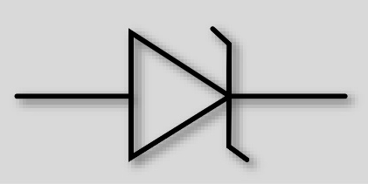
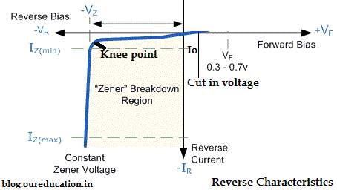
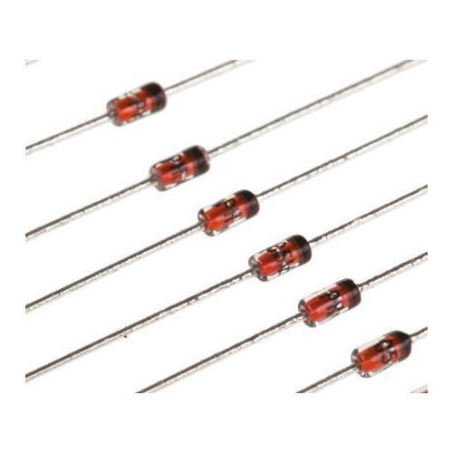
Zener Diode
Zener Diode Symbol
A zener diode is a silicon pn junction device that is designed for operation in reverse breakdown region.
The breakdown voltage is set by carefully doping it at the manufacturing level.
The operating principle is based on the fact that the diode voltage remains constant after the breakover voltage for a large change in current.
Zener Diode package

Slide 7
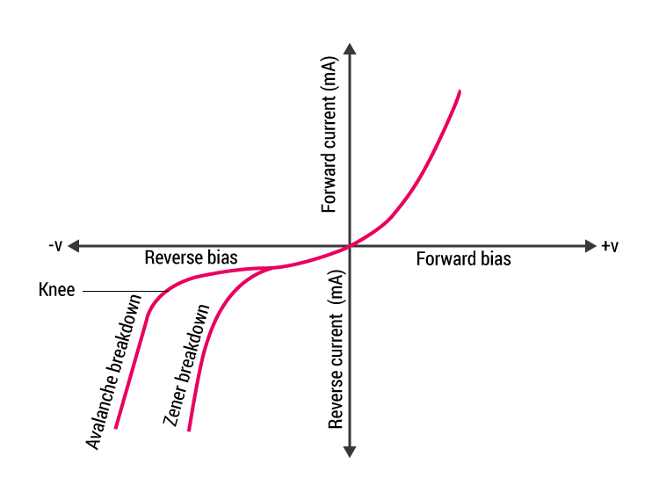
Zener Diode
The zener diode is heavily doped to reduce the breakdown voltage. This causes a very thin depletion layer. As a result, an intense electric field exists within the depletion region.
Near breakdown region, the field is intense enough to pull electrons from their valence bands and create current.

Slide 8
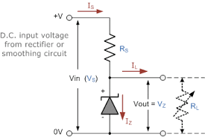
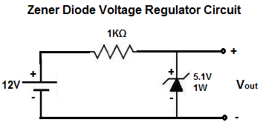
Zener Diode
Zener Diode as a voltage regulator.
Temperature coefficient: Defines the percentage change in zener voltage per degree Celsius change in temperature.
$$∆V_{Z}=V_{Z}∗TC∗∆T$$

Slide 9
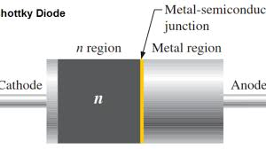
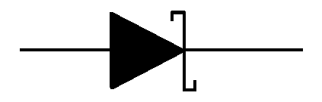
Schottky Diode
Schottky diodes are high current diodes used primarily in high frequency and fast switching applications.
Also known as hot carrier diodes. (high energy level of electron in n-region compared to those in metal region.)
It is formed by joining a semiconductor (n-type) with a metal such as gold, silver or platinum.
The metal region is heavily doped and n-type region is lightly doped.
There are no minority carriers. When forward biased, higher energy electrons in n-region are injected into the metal where they give up their excess energy. (in conduction band).
Since there are no minority carriers, there is a very rapid response to change in bias.

